Slide 1
18EC64 MODULE-4

Slide 2
STRUCTURED VERSUS UNSTRUCTURED DATA

Slide 3
IOT DATA ANALYTICS

Slide 4
IOT DATA ANALYTICS CHALLENGES
SENDING PROBLEM
VALIDITY OF DATA

Slide 5
MACHINE LEARNING
SUPERVISED LEARNING
UNSUPERVISED LEARNING

Slide 6
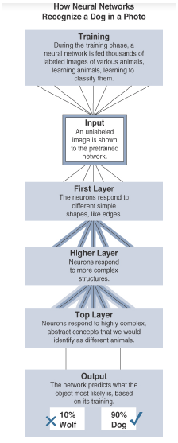
NEURAL NETWORK

Slide 7
Machine Learning and Getting Intelligence from Big Data
Local learning
Remote learning
four major domains
-Monitoring
-Behavior control
-Operations optimization
-Self-healing, self-optimizing

Slide 8
BIG DATA ANALTICS TOOLS AND TECHNLOGY
-Velocity
-Variety
-Volume

Slide 9
MASSIVELY PARALLEL PROCESSING DATABASES

Slide 10
NoSQL Databases
Document stores
Key-value stores
Wide-column stores
Graph stores

Slide 11
HADOOP

Slide 12
EDGE STREAMING ANALYTICS
Reducing data at the edge
Analysis and response at the edge
Time sensitivity

Slide 13
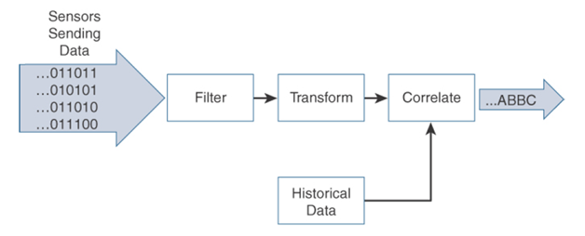
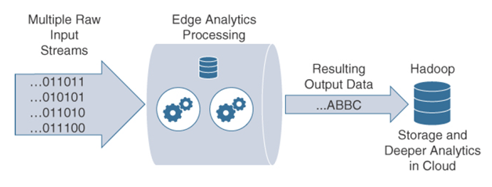
EDGE ANALYTICS CORE FUNCTIONS
Raw input data
Analytics processing unit (APU)
Output streams

Slide 14
DISTRIBUTED ANALYTICS SYSTEMS

Slide 15
NETWORK ANALYTICS
Network traffic monitoring and profiling
Application traffic monitoring and profiling
Capacity planning
Security analysis

Slide 16
FLEXIBLE NETFLOW ARCHITECTURE
FNF Flow Monitor (NetFlow cache)
FNF flow record
FNF Exporter
Flow export timers
NetFlow export format
NetFlow server for collection and reporting

Slide 17
COMMON CHALLENGES IN OT SECURITY
Erosion of Network Architecture
Pervasive Legacy Systems
Insecure Operational Protocols
-Modbus
-DNP3 (Distributed Network Protocol)
-ICCP (Inter-Control Center Communications Protocol)
-OPC (OLE for Process Control):

Slide 18
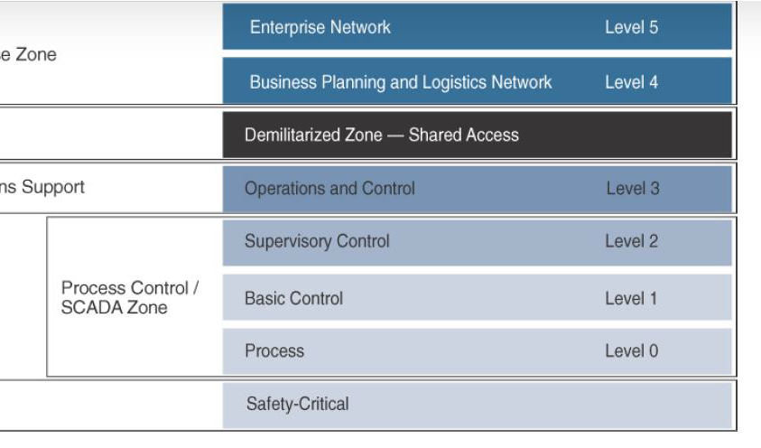
HOW IT AND OT SECURITY PRACTICES AND SYSTEMS VARY
The Purdue Model for Control Hierarchy

Slide 19
FORMAL RISK ANALYSIS STRUCTURES: OCTAVE AND FAIR

